Slide 1
JPSS/NPP
Report and Discussions
Elena Pourmal, Mike Folk, Kent Yang
The HDF Group
April 6, 2010

Slide 2
HDF-JPSS Team
Frank Baker
Scot Breitenfeld
Allen Byrne
Peter Cao
Albert Cheng
Michael Folk
Barbara Jones
Jonathan Kim
Larry Knox
Mike McGreevy
Herbert Morgan
Elena Pourmal
Muqun {Kent} Yang

Slide 3
Goal
Provide HDF5 risk-reduction support for the distribution of NPOESS VIIRS, OMPS, and other sensor and environmental data products

Slide 4
Areas of primary need
Easy and intuitive data access and use by diverse communities
Allow producers and consumers to view content, manage metadata, and convert data to other formats.
High-quality, rapid-response HDF5 support for JPSS/NPP users at all levels.

Slide 5
2010-2011 Priorities
Provide high quality user support
  Provide high priority helpdesk support and technical backup
  Engage regularly with JPSS community
Maintain software on platforms used by NPP/JPSS
  Test on NASA mini-IDPS
  Test regularly on certain Linux, Windows and Mac platforms
  Test Backward/forward compatibility with GRAVITE files
Develop software to facilitate access and management of NPP/JPSS data
  H5edit
  High level region reference library
Improve accessibility and usability of NPP/JPSS data products
  Harmonize JPSS products with netCDF

Slide 6
NPP/JPSS Project Information
Project Web site
  http://www.hdfgroup.org/projects/npoess/
  Project description
  Released software
  Documentation
Project Wiki site
  http://wiki.hdfgroup.org/NPOESS-Project
  Monthly progress reports, links to software under development, presentations, etc.
    Requires a password
    Contact epourmal@hdfgroup.org

Slide 7
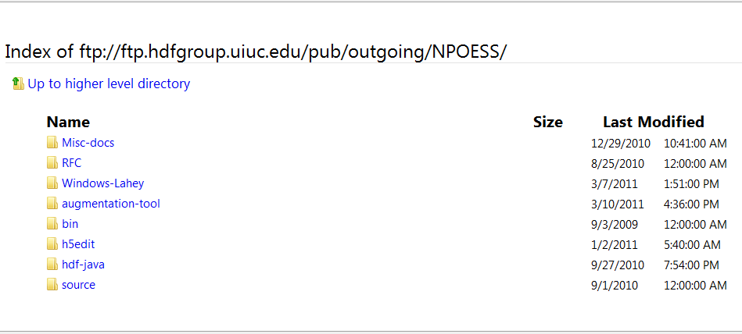
JPSS Software FTP Site

Slide 8
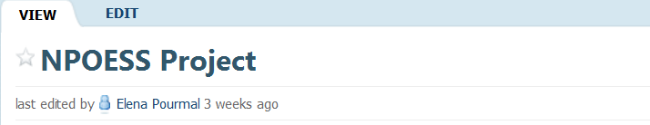
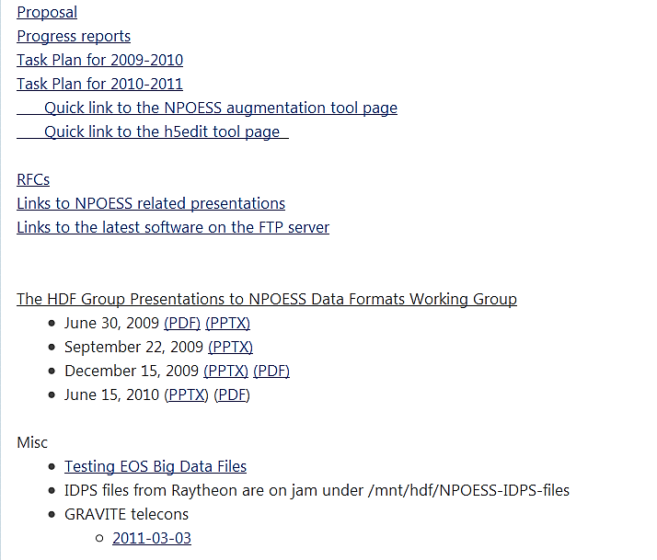
HDF NPOESS Wiki

Slide 9
helpdesk support and technical backup regular Engagement with the community

Slide 10
NPP/JPSS User Support
Priority support to NPP/NPP users
  Send email to help@hdfgroup.org
  Responding to “NPOESS”, “NPP”, or “JPSS” in subject field
    Subject: [NPOESS] Where is the plug-in?
    Subject: [NPP] Why my program doesn’t work?
    Subject: [JPSS] Need a tool to edit files with references
    This has worked well, though occasionally we have to guess
Special tasks, such as
  Porting to requested compilers and systems
  Performance tuning for applications
We want to hear from you!

Slide 11
Special tasks through support desk
Compression project
  Proposed to use compression when files generated
  Showed big savings on file size with minimum effect on code to generate files
Lahey project
  Helped scientist adapt Lahey compiler to work with 1.8.6

Slide 12
Testing on platforms important to NPP/JPSS

Slide 13
Testing NPP/JPSS platforms and files
HDF5 Testing on NASA mini-IDPS
  Working to make sure major releases and patches work on Mini-IDPS machine running AIX 5.3
  Help IDPS staff with building issues
  Included as a pre-release test machine
Other platform testing
  Linux 32-bit and 64-bit
  Windows 32-bit and 64-bit
  Mac Intel
Backward/forward compatibility testing with GRAVITE files

Slide 14
Software to Facilitate NPP/JPSS data access and management

Slide 15
Software support
Support and enhance HDFView and h5dump
  All new features now in official release
Maintaining high level region reference API
H5edit

Slide 16
h5edit
A new tool to add/delete/modify objects in HDF5 files

Slide 17
The need for a file editor
Currently, to do simple editing tasks a user has to write an HDF5 application or use HDFView.
Examples
  Add an attribute to a dataset in an HDF5 file that is needed by a visualization tool.
  Change the name of an existing attribute because of typos in the creation program.

Slide 18
H5edit
A tool to edit objects in an HDF5 file
Initial focus: attributes
Initial functions:
  create: create a new attribute in an object
  delete: delete an existing attribute from an object

Slide 19
Status
Implemented: “create” and “delete” commands
  Supports most common datatypes
  Example:
  h5edit –c “CREATE /dataset2 km2ml {{0.6}}” highway.h5
Possible new features to implement
  rename: modify the name of an attribute
  modify: modify the value of an attribute
  copy: copy an attribute from one object to another
  move: move an attribute from one object to another

Slide 20
H5Edit Resources links
Proposal
  http://www.hdfgroup.uiuc.edu/RFC/HDF5/h5edit/H5edit-RFC-Draft-v5.pdf
H5Edit information
  ftp://hdfgroup.uiuc.edu/pub/outgoing/NPOESS/h5edit/
H5Edit Man Page
  ftp://hdfgroup.uiuc.edu/pub/outgoing/NPOESS/h5edit/h5edit.pdf
H5Edit User Guide
  ftp://hdfgroup.uiuc.edu/pub/outgoing/NPOESS/h5edit/H5edit_User_Guide.pdf
H5Edit Source Code
  ftp://hdfgroup.uiuc.edu/pub/outgoing/NPOESS/h5edit/h5edit.tar.gz

Slide 21
Harmonizing NPP/JPSS products with netcdf

Slide 22
Background
JPSS/NPP data products will be distributed in HDF5.
Many JPSS/NPP data consumers need to access JPSS/NPP data products using applications that work best with netCDF files.
Although netCDF-4 uses the HDF5 format, there are some issues that prevent netCDF-based applications from either accessing JPSS/NPP products or using them effectively.

Slide 23
GOAL
Improve the accessibility and usability of JPSS/NPP data by netCDF-4 applications

Slide 24
Project Objectives
Understand issues involved in providing full access to NPP/JPSS data products by netCDF-4 users and applications.
Provide solutions, such as a tool that changes JPSS/NPP data products to make them accessible and usable by netCDF applications.
Implement the first version of the solution by June, in time to assist calibration/validation activities.

Slide 25
Problems to address
NetCDF-4 library cannot access JPSS/NPP data products
Components of netCDF data model are not scientifically meaningful
JPSS/NPP file lacks critical scientific metadata needed by applications

Slide 26
Problem 1
NetCDF-4 library cannot access JPSS/NPP data products
  NPP/JPSS HDF5 files contain objects that netCDF-4 library cannot read
    HDF5 datasets with object and region references
    Multidimensional HDF5 attributes
Result: netCDF-4 library fails to open JPSS/NPP file

Slide 27
Problem 2
Components of netCDF data model are not scientifically meaningful
  netCDF-4 creates fake dimensions in order to conform to the data model
Result: Valuable information unavailable to application or user to obtain meaningful results

Slide 28
Problem 3
JPSS/NPP file lacks critical scientific metadata needed by applications
  Inadequate scientific metadata for specific applications
  Required metadata may only exist outside of the HDF5 file
  Required metadata may not conform to standards or conventions
Result: applications malfunction or fail to provide useful results

Slide 29
Initial Solution
A HDF5-JPSS Augmentation Tool
“h5augjpss”

Slide 30
Requirements
The tool shall modify NPP/JPSS product files so as to satisfy the following:
  All objects in the augmented file are readable by the netCDF-4.1 library and later.
  The augmented file has meaningful dimensional and other metadata information to interpret the data by the netCDF-4.1 library and later.
  The augmented file has critical metadata needed by a set of the netCDF-4 applications (TBD), such as UCAR’s IDV
The tool shall be a command line tool

Slide 31
Assumptions
Initial implementation will focus on non-packed non-aggregated NPP/JPSS data products
Three files are available to a user:
  NPP/JPSS data product file (HDF5 file)
  NPP/JPSS XML product file with the metatdata for the NPP/JPSS product file (XML file)
  NPP/JPSS geolocation product file (HDF5 file)
The tool shall augment an NPP/JPSS product file using information found in the corresponding NPP/JPSS XML product file and NPP/JPSS geolocation product file

Slide 32
Assumptions
It is user’s responsibility to provide valid JPSS/NPP files
It is acceptable that some HDF5 objects (groups, datasets and their attributes) in the original file are not accessible in the augmented file
It is acceptable that the augmented file may require additional modifications to visualize data

Slide 33
Recap: Problems to address
NetCDF-4 library cannot access JPSS/NPP files
Components of netCDF data model are not scientifically meaningful
JPSS/NPP file lacks critical scientific metadata needed by applications

Slide 34
Augmentation Solution
Step 1: Augment a file to make it readable by the netCDF-4 library and ncdump utility.
Step 2: Augment the file with dimensional information and other metadata found in the NPP/JPSS XML product file
Step 3: Augment the file with the geolocation information needed for visualization tools based on the netCDF library.

Slide 35
Augmentation Steps
Each step shall perform independently
Default tool’s behavior to perform steps in order: Step1, Step 2, Step 3
Flow diagram and result of three steps are shown on the next two slides

Slide 36
File.h5
h5augjpss
Step 1: Hide HDF5 objects unknown to netCDF-4
FILE.h5
NetCDF-4 readable file
FILE.XML
Step 2: Update with information from FILE.XML according to SPEC
FILE.h5
NetCDF-4 meaningful file
GEO.h5
Step 3: Update with geo-location info from GEO.h5 and CF metadata
FILE.h5
NetCDF-4 tools readable file

Slide 37
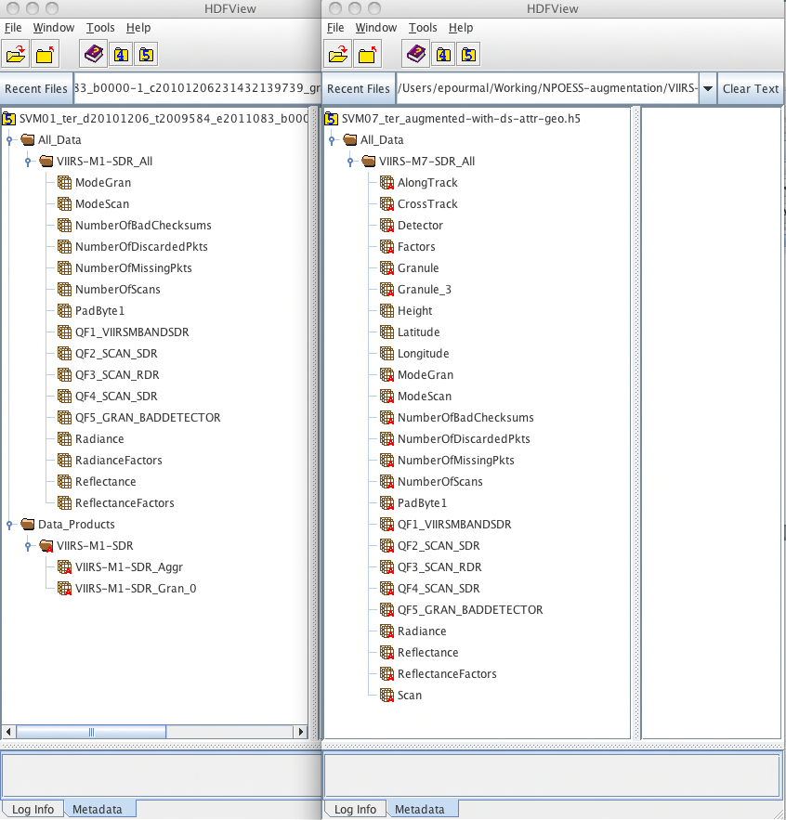
Dimension Scales
Geolocation
Original file in HDFView
New attributes
Augmented file file in HDFView

Slide 38
Augmentation Step 1
Purpose: Make an NPP/JPSS file readable by the netCDF-4 library
Solution: Hide HDF5 objects unknown to netCDF-4
Result:
  All objects left can be accessed by netCDF-4
  Some objects are not accessible anymore
    /Data_Products group and all datasets underneath it
    Can be restored later if desired
  Minimum file structure modification

Slide 39
Example of problem 1: ncdump
  “netCDF-4 library fails to open JPSS/NPP file”
./ncdump SVM07_.....h5:
NetCDF: Bad type ID

Slide 40
Example: Result of Step 1
./ncdump SVM07_ter_augmented-step1
netcdf SVM07_ter_augmented-step1 {
// global attributes:
string:N_GEO_Ref = ….
….
group: All_Data {
group: VIIRS-M7-SDR_All {
dimensions:
….
phony_dim_3 = 768 ;
phony_dim_4 = 3200 ;
variables:
….
float Radiance(phony_dim_3, phony_dim_4) ;
….
} // group VIIRS-M7-SDR_All
} // group All_Data
}

Slide 41
Augmentation Steps: Step 2
Purpose: Add metadata information from XML product file to JPSS product file
Solution: Read information stored in the XML file and store it in the JPSS product file
Result:
  Dimensional information is available in JPSS product file
  Other JPSS metadata information is available in JPSS product file
  File undergoes substantial structural modification
What metadata should we bring from XML?

Slide 42
Example: Result of Steps 1 + 2
netcdf SVM07_ter_augmented-step1-step2 {
// global attributes:
……..
group: All_Data {
group: VIIRS-M7-SDR_All {
dimensions:
AlongTrack = 768 ; Meaningful dimensions
CrossTrack = 3200 ;
…
variables:
int AlongTrack(AlongTrack) ; Coordinate variabl
….
float Radiance(AlongTrack, CrossTrack) ;
Radiance:DatumOffset = 0 ;
Radiance:Scaled = 1 ;
string Radiance:MeasurementUnits = "W/(m^2 μm sr)" ;
….
} // group VIIRS-M7-SDR_All
} // group All_Data New attributes
}

Slide 43
Augmentation Steps: Step 3
Purpose: Make geolocation information from GEO product file available in JPSS product file to be usable by netCDF-4 visualization tools
Solution: Copy datasets “Longitude”, “Latitude”, and “Height” from the GEO file to product file
Result:
  Geolocation information is available in the JPSS product file along with raw data
  File size may substantially increase

Slide 44
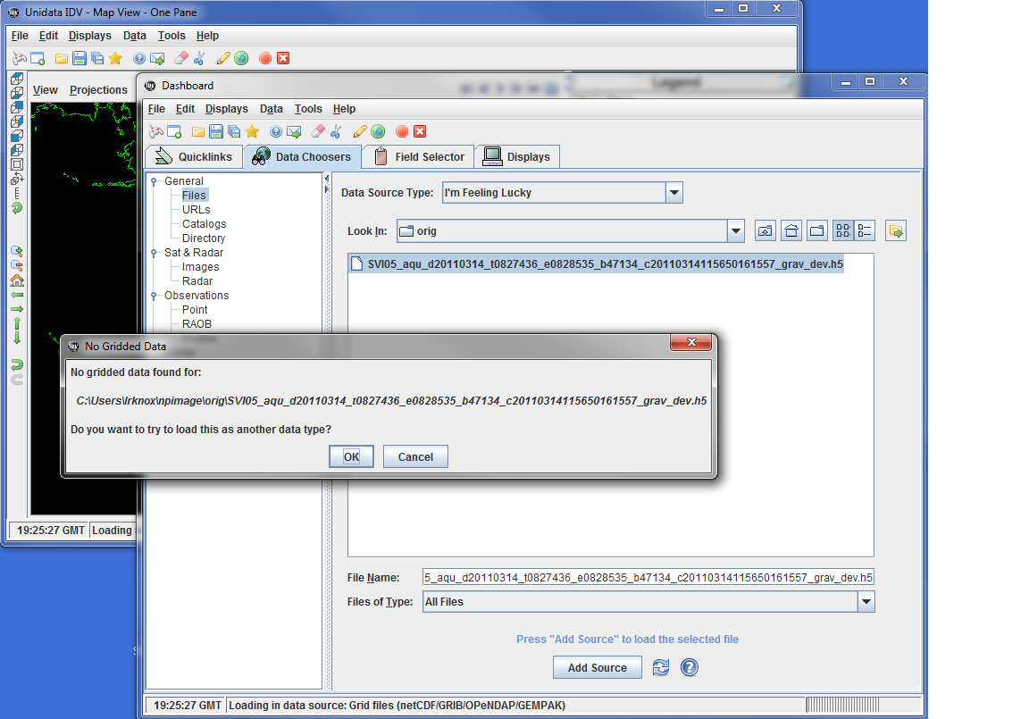
Example: Using IDV with Augmented File

Slide 45
IDV Specific Changes
Make all datasets available in a ROOT Group
  IDV is based on netCDF classic model
  IDV doesn’t understand groups
  Solution:
    Added paths to datasets to the Root group
    Hided original /All_Data group
Add IDV required attributes
  May require domain knowledge (scale factors, offsets, and where to find them)

Slide 46
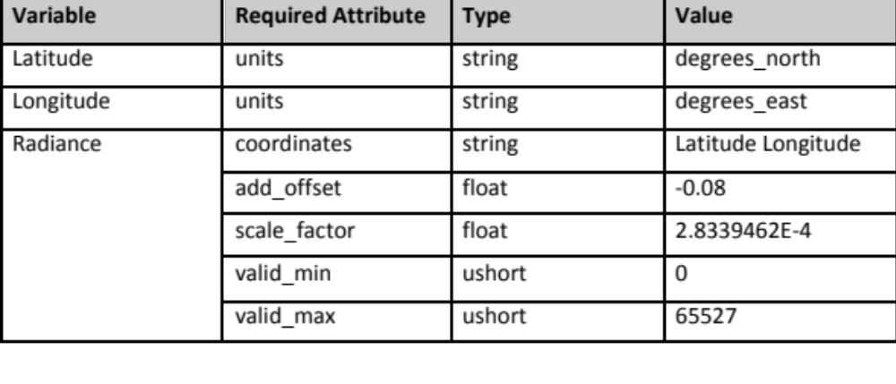
Example: IDV Required HDF5 Attributes

Slide 47
Using h5edit tool to add attributes
% h5edit -c "CREATE /Radiance scale_factor {H5T_IEEE_F32LE SIMPLE(1) DATA{2.8339462E-4}};" SVM07…..h5
% h5edit -c "CREATE /Longitude units {H5T_STRING { STRSIZE 12 } DATA {'degrees_east'}};” SVM07…..h5

Slide 48
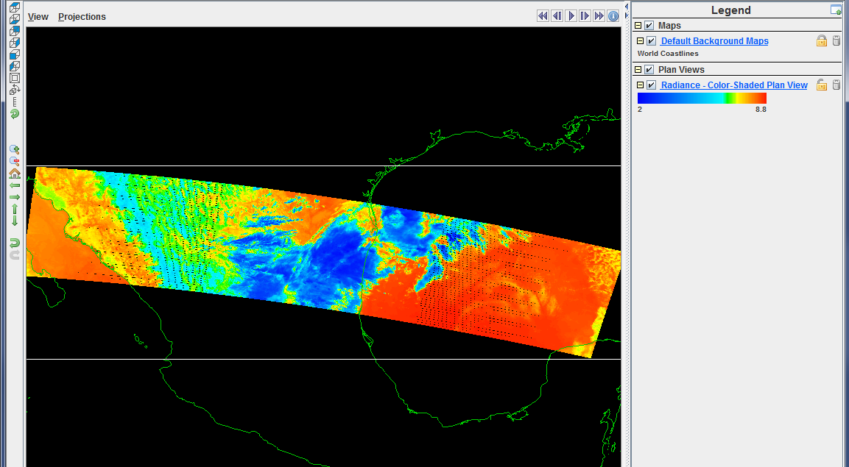
Example: “Radiance” Variable in IDV

Slide 49
CF Support for JPSS-augmented Files

Slide 50
CF conventions
Climate and Forecast Metadata conventions (CF conventions) are widely accepted by earth science user communities
CF conventions are followed by several popular netCDF tools to display and analyze netCDF-4 data.
JPSS XML files contain metadata information defined by CF conventions.

Slide 51
Why CF?
CF attributes are necessary to properly display augmented files via popular netCDF tools.

Slide 52
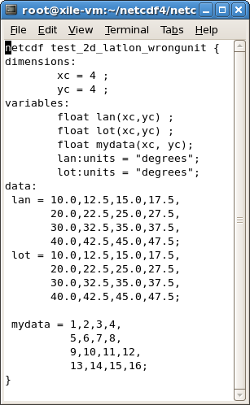
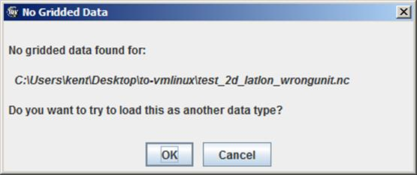
An example not following CF
Do not follow CF

Slide 53
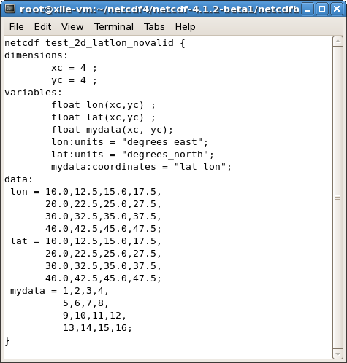
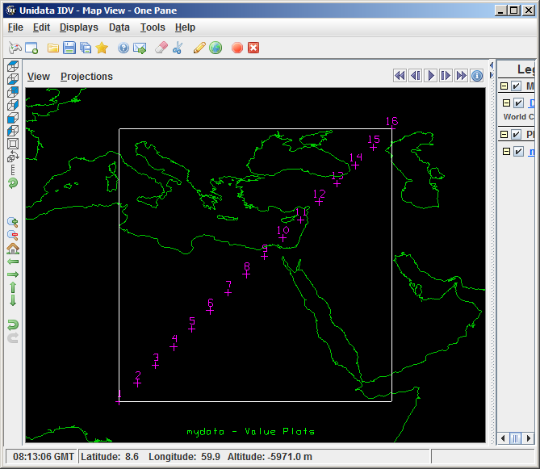
An example following CF
Follow CF

Slide 54
Approaches
Investigate the key CF requirements for tools to access JPSS-augmented files
Investigate the equivalent CF information at JPSS data and XML files
Collect questions and issues to ask the JPSS team
Provide suggestions and solutions for mapping JPSS metadata to CF-compliant metadata
Notes:
I am not sure if you want to talk some details about key CF attributes. If yes, let me know.

Slide 55
Project status
“HDF5 Augmentation Tool for NPP/JPSS Product Files. Requirements, Design and Mapping Specifications”
  http://www.hdfgroup.uiuc.edu/ftp/pub/outgoing/NPOESS/augmenttion-tool/h5augjpss.pdf
“Quick and dirty” prototype of the h5augjpss tool is available on demand

Slide 56
Project Status
A draft of comprehensive document about CF support for JPSS-augmented files
http://www.hdfgroup.uiuc.edu/ftp/pub/outgoing/NPOESS/augmentation-tool/CF-JPSS.pdf
Successfully display sample JPSS files via IDV after CF attributes are added
Notes:
Elena can provide the URL for the draft document
I am not sure it is the good time to list some key questions we want to ask. Now I just leave it alone.

Slide 57
Other augmentation issues

Slide 58
Identifying key tools to test
What tools are important for netCDF users?
  We’re testing IDV
  What other tools should we be investigating?
  Who should we be working with and how?

Slide 59
Future Work

Slide 60
Future work - Overview
Finish h5edit
Deploy/maintain software
Streamline testing on mini-IDPS
Achieving netCDF compatibility for JPSS
User support

Slide 61
Deploy/maintain software
Deploy and maintain new features
  Includes APIs, command line tools, HDFView.
Improve products based on feedback from NPP/JPSS customers and users.
Perform testing, documentation, bug fixes, source and binary releases.

Slide 62
What scientists can we work with?

Slide 63
Discussion
What scientists can we work with?
  Need help with identifying metadata in XML product file to be brought to the augmented file (all, some?)
What tools are important for netCDF users?
  What other tools should we be investigating?
Questions and comments from the audience.

Slide 64
Thank You!

Slide 65

Questions?

Slide 66
Acknowledgements
This work was supported by NOAA/NESDIS contract DG133E07CQ0055 with Prime Contractor Riverside Technology, inc. The work reported on here is part of Task Order No. 18: IPO/JPSS support.
Any opinions, findings, conclusions, or recommendations expressed in this material are those of the author[s] and do not necessarily reflect the views of the project sponsors or the prime contractor.

